Slide 1
Managing
User Impatience
Nick Dell’Orco, Yilun Liang, Keith Stebler

Slide 2
User Impatience Governor
Governor: Application that controls CPU frequency
Cater performance to the desires of the user
Not too much that it saps the battery
Not too little that the user is unhappy
Think Goldilocks

Slide 3
Virtual User Evaluation Testing System
Purpose:
Test on users of varying levels of patience.
Stress the governor to optimize functionality.
Compare functionality with other governors

Slide 4
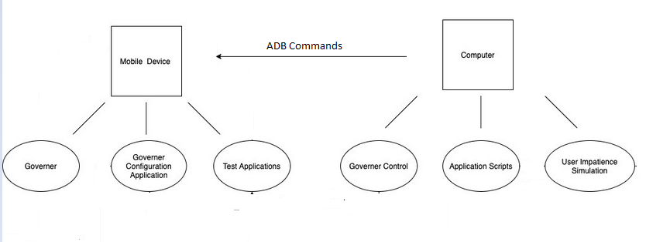
Testing Setup
Diagram:

Slide 5
Testing Setup
Setup:
Device
Governors
Governor Configuration Application
Applications
Computer
Governor Control → Set and configure the governor
Application Scripts → Uses the scripts to simulate the user’s action.
User Impatience Simulation → Simulates the different types of users and their patience level.

Slide 6
System Design
Old System:
Probability-Based System:
Roll the dice to determine if a user is impatient
Problems:
Does not correlate to intention
Independent of application
Results in the CPU maximizing or minimizing

Slide 7
New System Idea:
Time-based System
Compare time of a task vs. patience time of the user.
Advantages:
Complaints have a determinable correlation.
Get actual performance of applications
Problems:
Non-CPU performance factors.
Additional Overhead.

Slide 8
New System Design:
Two parts to the new system:
Setup:
Record task time running at optimal performance.
Eliminate previously mentioned problems.
User Simulation
User >= Task Time - Optimal Time → Happy
User < Task Time - Optimal Time → Not Happy

Slide 9
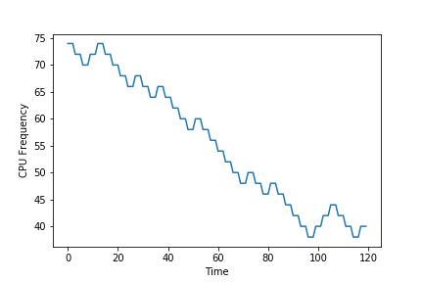
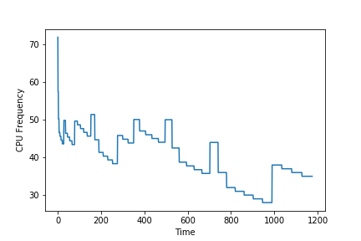
How To Decrease CPU Frequency?

Slide 10
Moving Forward
Start Working on Governor
Issues to be addressed:
Chance to ignore the minimum threshold.
Short interval results in inaccurate readings.
Script length is insufficient.

